Slide 1


Google Analytics Report
Group 10
Danapriti Lakshmi Priyanka Alluri
Ankita Bargaje
Rukkaiya Patthawala
Maneka Prabhu
Amisha Shukla
Vaibhav Rajan Thakur

Slide 2


About
About Fabletics:
Fabletics is a global activewear brand operated on a membership model where its VIP members get access to exclusive deals, discounts and new merchandise.
The company is known for its unique e-commerce store that serves over 2 million members, although it does have 85 brick-and-mortar outlets.
In Mar '22, Fabletics launched its all-inclusive shapewear brand, Yitty, in collaboration with singer, Lizzo.
Mission:
To create the world’s most fashionable, high-performance active lifestyle products for everyone and everybody - at an accessible price.
Vision:​
Inclusivity inspires everything Fabletics does.
At Fabletics, everyone and every body type is welcome.
They position Fabletics as more than activewear, it's Active Life Wear.
Notes:
https://www.pxfuel.com/en/free-photo-iuopd

Slide 3
Business Objectives
 | Revenue Growth | User Experience | Global Expansion
Metrics Used for measurement | Revenue by categories Revenue by devices Conversion rate Average order value Checkout abandonment rate | Sessions Conversion rate Bounce rate Session duration | Revenue by geographical locations
Revenue Growth:
Grow the revenue for Yitty X3 by 2028.
Improved User Experience:
Increase the average time spent on site X2 by 2028.
Expand Fabletics global revenue:
- Increase the international revenue X5 by 2028.

Slide 4
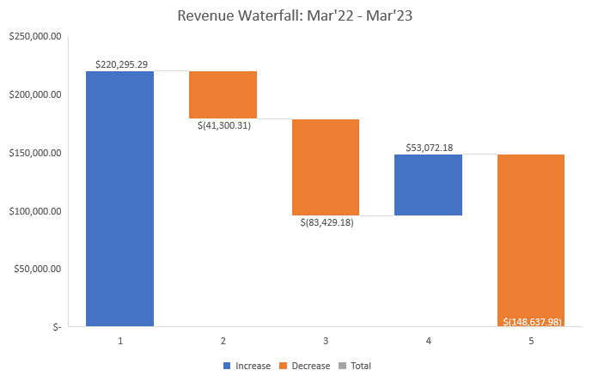
Revenue Waterfall
There is a decrease in the number of visits (17% approx.) as well as conversion rate (33%) when compared with March 2022. However, the average order value shows an increase of 21.2% for 2023.
Overall, there is a decline of approx. 33% in revenue from last year, primarily driven by the decrease in conversion rate from 2.61% in 2022 to 1.74%.
The decline in revenue due to the number of visits is almost offset by the increase in average order value from $107 in Mar'22 to $130 in Mar'23.
LY
Visits
Conversion rate
AOV
TY
Metrics | TY | LY | (#LY) | (%LY) | Impact
Revenue | $148,637.98 | $220,295.29 | $(71,657.31) | -32.53%
Visits | 65,747 | 78,740 | -12,993 | -16.50% | -$(41,300.31)
Conversion rate | 1.74% | 2.61% | -0.87% | -33.33% | -$(83,429.18)
AOV | $129.81 | $107.10 | $22.71 | 21.20% | $53,072.18

Slide 5
Revenue by categories
There is a decline in the 2 top categories for Fabletics including its new line - Yitty - which reflects a 40.90% decrease in revenue.

Slide 6
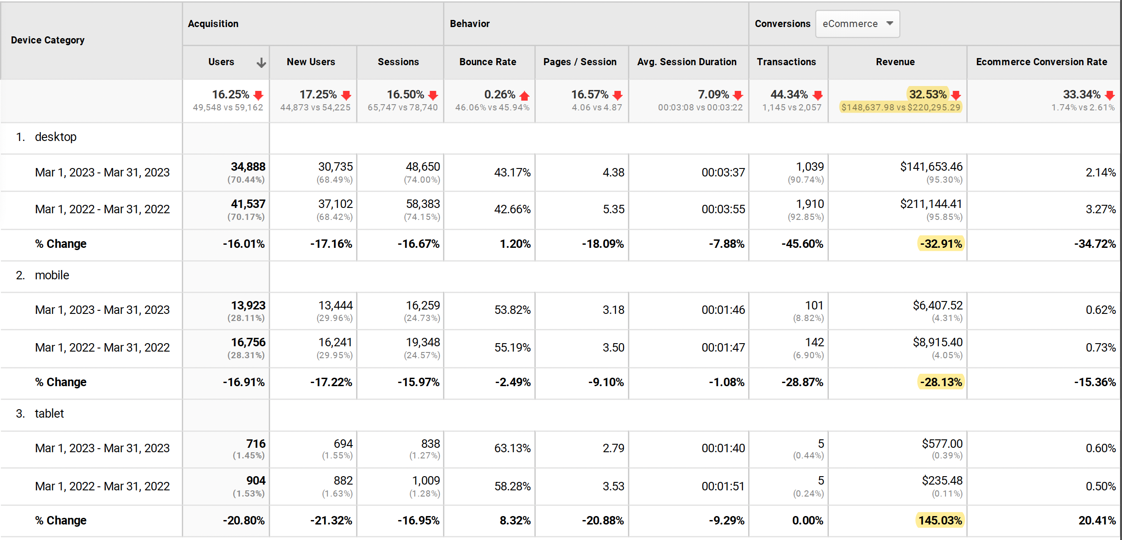




Revenue by device type

Slide 7
Recommendations
The two major categories for Fabletics – Outfits and Yitty – have registered a significant decline in revenue (over 40%) since 2022 based on analysis by product categories. Fabletics should consider retargeting the audience of its celebrity ambassador, Lizzo to push its shapewear range to meet the business objective for this new line.
Given its membership-based model, an email campaign offering discounts on app, in-store as well as on website to its existing members who haven't purchased shapewear yet can lead to more trials.
Fabletics can also introduce a referral system specifically for these categories to encourage current members to refer their family and friends and provide rewards and discounts and benefits to both the referrer and the refree.
Based on the breakdown by device type, there is a significant increase in revenue and conversion rate for tablet from last year, while mobile and desktop have registered a decline. However, given the number of transactions on this device type are still the same - 5, Fabletics can consider customizing its ad campaigns to this suit tablets, but they should explore activities that people pursue on this device type to find oppurtunities for content/display partnerships.

Slide 8
% Goal Conversion Rate
All Goals
Goal 1 – Purchase completed
Goal 2 – Engaged Users
Goal 3 – Registrations
Goal 4 – Entered Checkout
Goal conversion Rate vs Total Abandonment Rate
Our website's goal conversion rate in March’22 was 21.9%, which indicates that roughly 22% of visitors who visited it accomplished a certain task (such completing a purchase).
When compared to the prior year, the goal conversion rate in March 2023 was 14.42%, a significant decrease. Additionally, from March 2022 to March 2023, the abandonment rate rose from 33.44% to 39.60%. The percentage of visitors to your website that left before achieving a goal is referred to as the abandonment rate.
Notes:
Goal conversion rate is a metric that measures the percentage of users who completed a specific goal on your website
Our website's goal conversion rate in March’22 was 21.9%, but in March 2023, it was 14.42%, indicating a significant decrease.
The percentage of visitors to your website that left before achieving a goal is referred to as the abandonment rate.
The abandonment rate increased from 33.44% to 39.60% during this time.

Slide 9
Goal Completions (March’22 vs March’23)
The largest decrease in Goal Completions was seen in Goal 3, which involves Registrations, while the largest number of completions was seen in Goal 2, which involves Engaged Users.

Slide 10
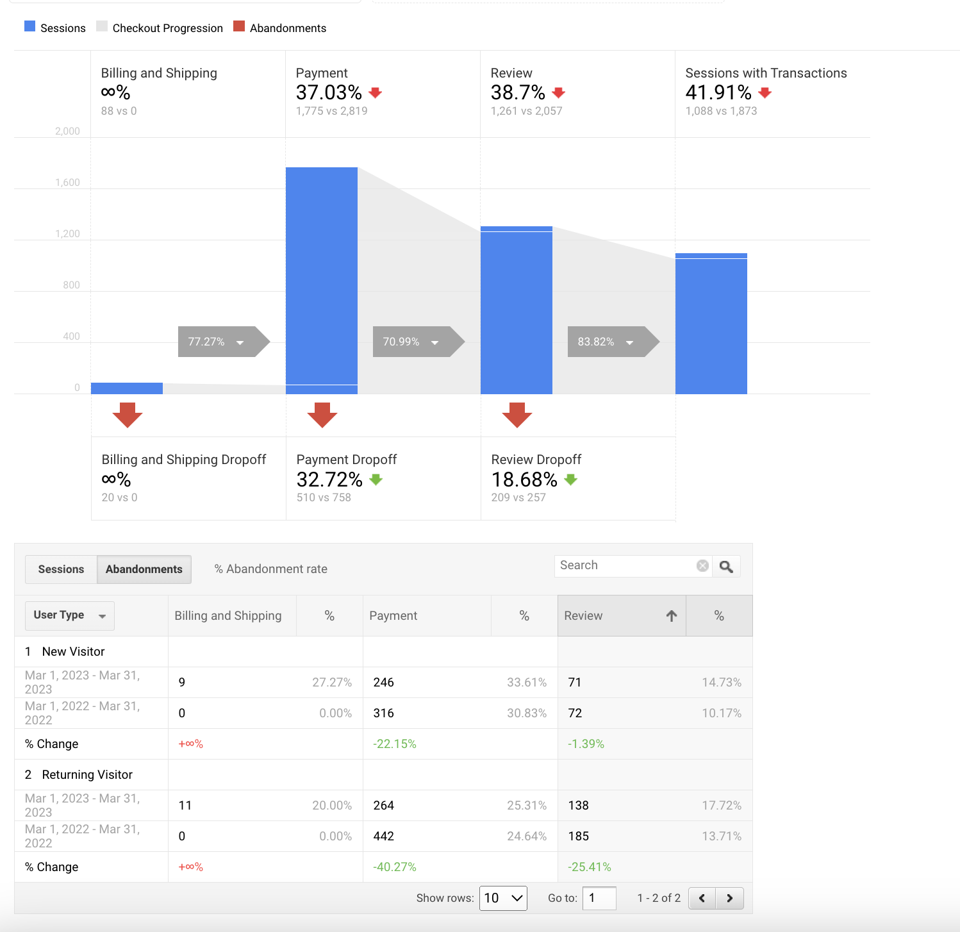
Checkout Abandonment Rate
The checkout abandonment rate significantly increased between March 2022 and March 2023, especially among repeat users, indicating that there are problems that need to be fixed to enhance the overall user experience.

Slide 11
Recommendations
To improve conversion rate and reduce abandonment rate here are some recommendations:
Improving website speed and user experience
Optimizing and Reviewing our checkout process
Implementing retargeting campaigns
Offers and promotions at checkouts
Goal completion recommendations:
Goal 3 : Registrations
Reduce the number of stages and required fields in the registration process
Encourage users to signup by providing rewards like exclusive content, savings, or early access to sales.
To make users' registration easier, offer social login choices
To improve each checkout stage –
Billing and Shipping Stage
To make it simpler for users to input their payment and shipping information, minimize the number of mandatory fields and simplify the form fields
Use of drop-down options or auto-fill to help users enter data more quickly
Payment Stage
Give users a variety of payment options
To win over users' trust, employ reputable payment processors
Review Stage
The review stage has to be clear and easy to understand
Describe the order in detail
Include any pertinent details, such as shipping and tax expenses.

Slide 12
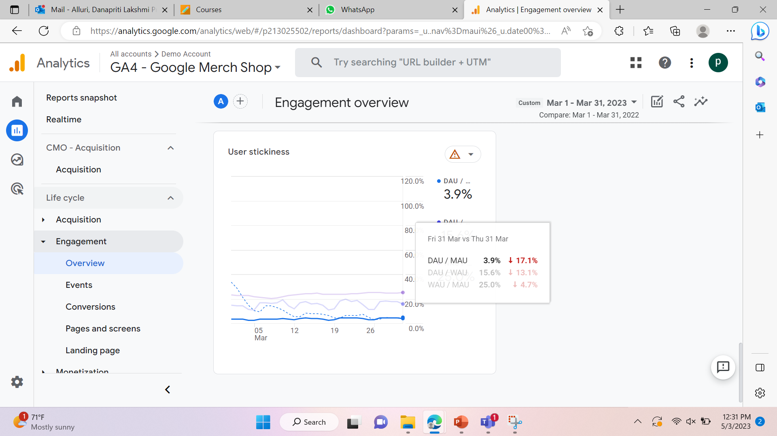
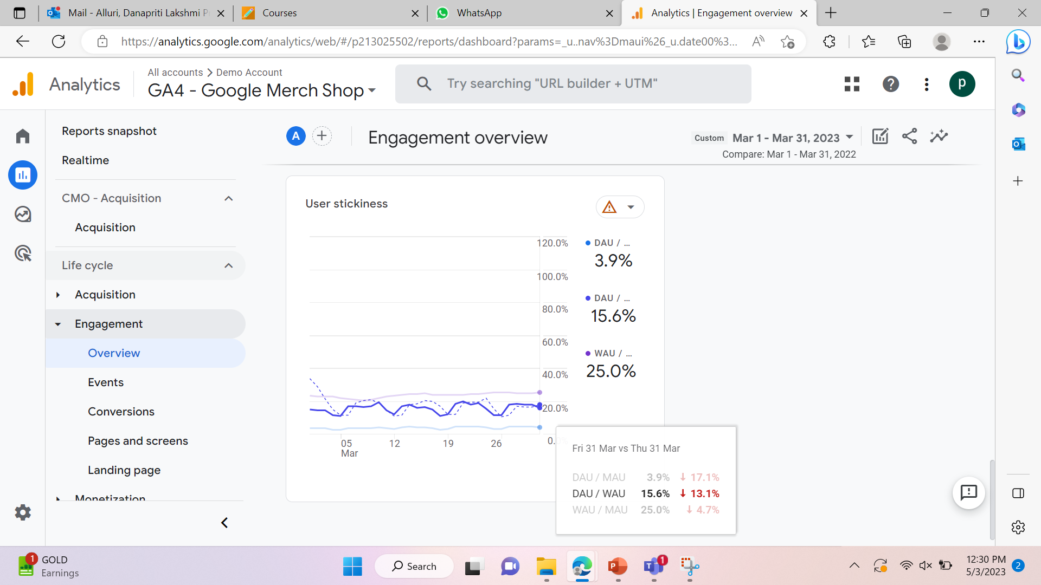

User Experience
User Stickiness
The following pictures indicate a clear dip in the DAU/MAU, DAU/WAU, and a significant down of the WAU/MAU in the year 2023 in comparison to 2022.
This is an indication that over time the website couldn't retain its customers efficiently which is an indication of poor user experience, further effecting the revenue and loyalty.

Slide 13
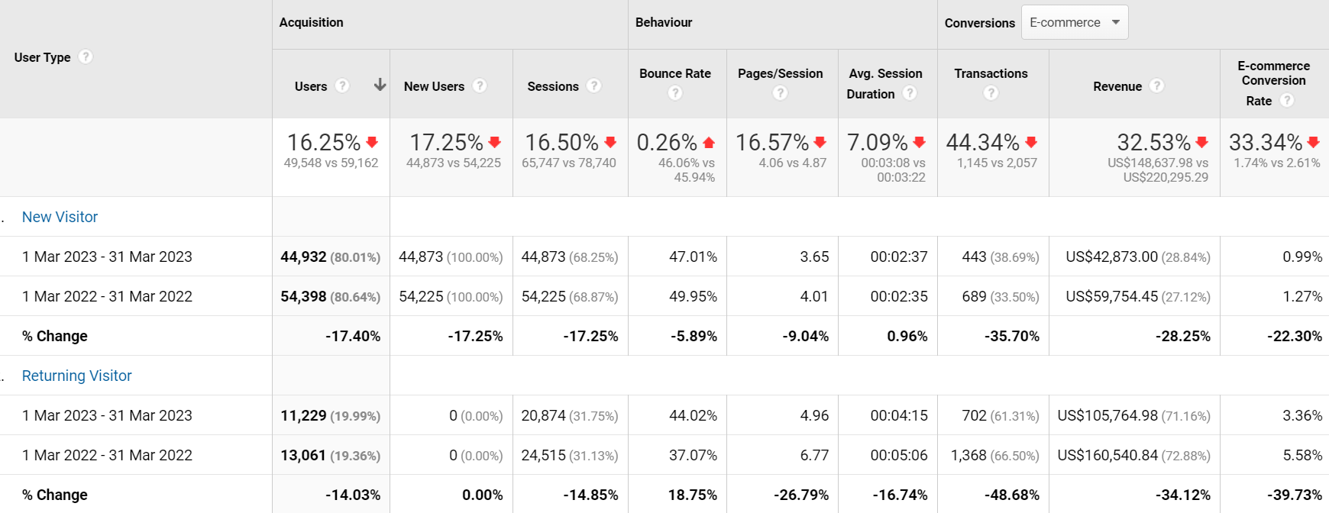
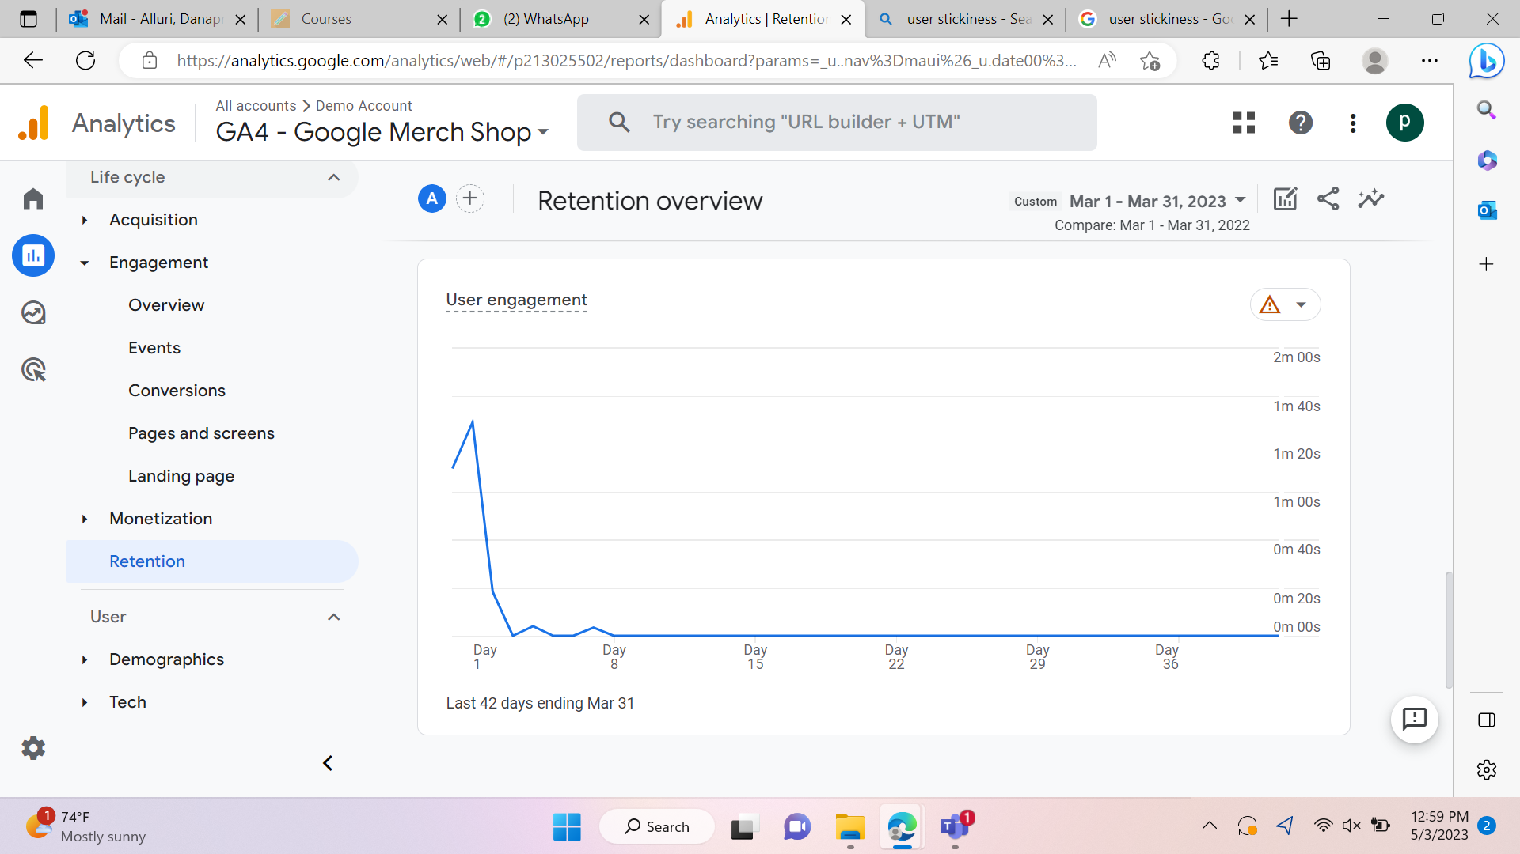
New Visitors vs Returning Visitors
We observe a clear decline in users, both new and returning during the period
A steep decline in number of transactions can be attributed majorly to a 18.75% rise in bounce rate within returning users.
The low user engagement rates indicate that these new/returning visitors are not as valuable as their interactions are low and are not getting converted into purchases.

Slide 14
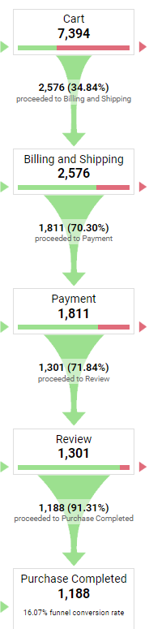
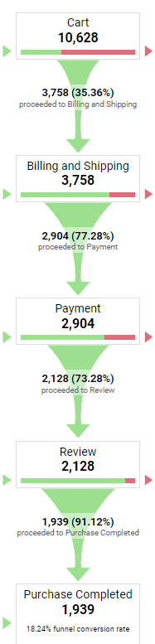
Conversion Report March 2023 vs 2022
2023
2022
We observe a fall in the funnel conversion rate from 18.24% in March 2022 to 16.07% in March 2023
Majority of the decrease can be attributed to the initial step of cart
Cart numbers show a fall of 30.43% from March 2022 to March 2023

Slide 15
Recommendations to Improve User Experience
Increase User Stickiness
Monitor user activity to give out potential purchase recommendations
Send out pop-up notifications of sign-up or discount offers to encourage the user to participate in a purchase
Improve User Experience on Website
Conduct a usability test by circulating a survey among a sample of customers to gather customer feedback related to the navigation of the website
Increase returning visitors to the website
Loyalty rewards program can be introduced to incentivize users to return and increase conversion rates
Automate email and text reminders to notify users to increase repeat purchases
Improve conversion rate
To decrease the cart abandonment rate, users can be repeatedly notified of items saved or added to the cart
We observed that approximately 30% did not flow through to the payment step after Billing and Shipping
Shipping rates can be revised to ensure it is not a deterrent to completing the purchase
Attempt to simplify the checkout process and ensure it is accessible and not time-consuming
Accept different modes of payment so that customers are not lost due to a lack of payment options

Slide 16
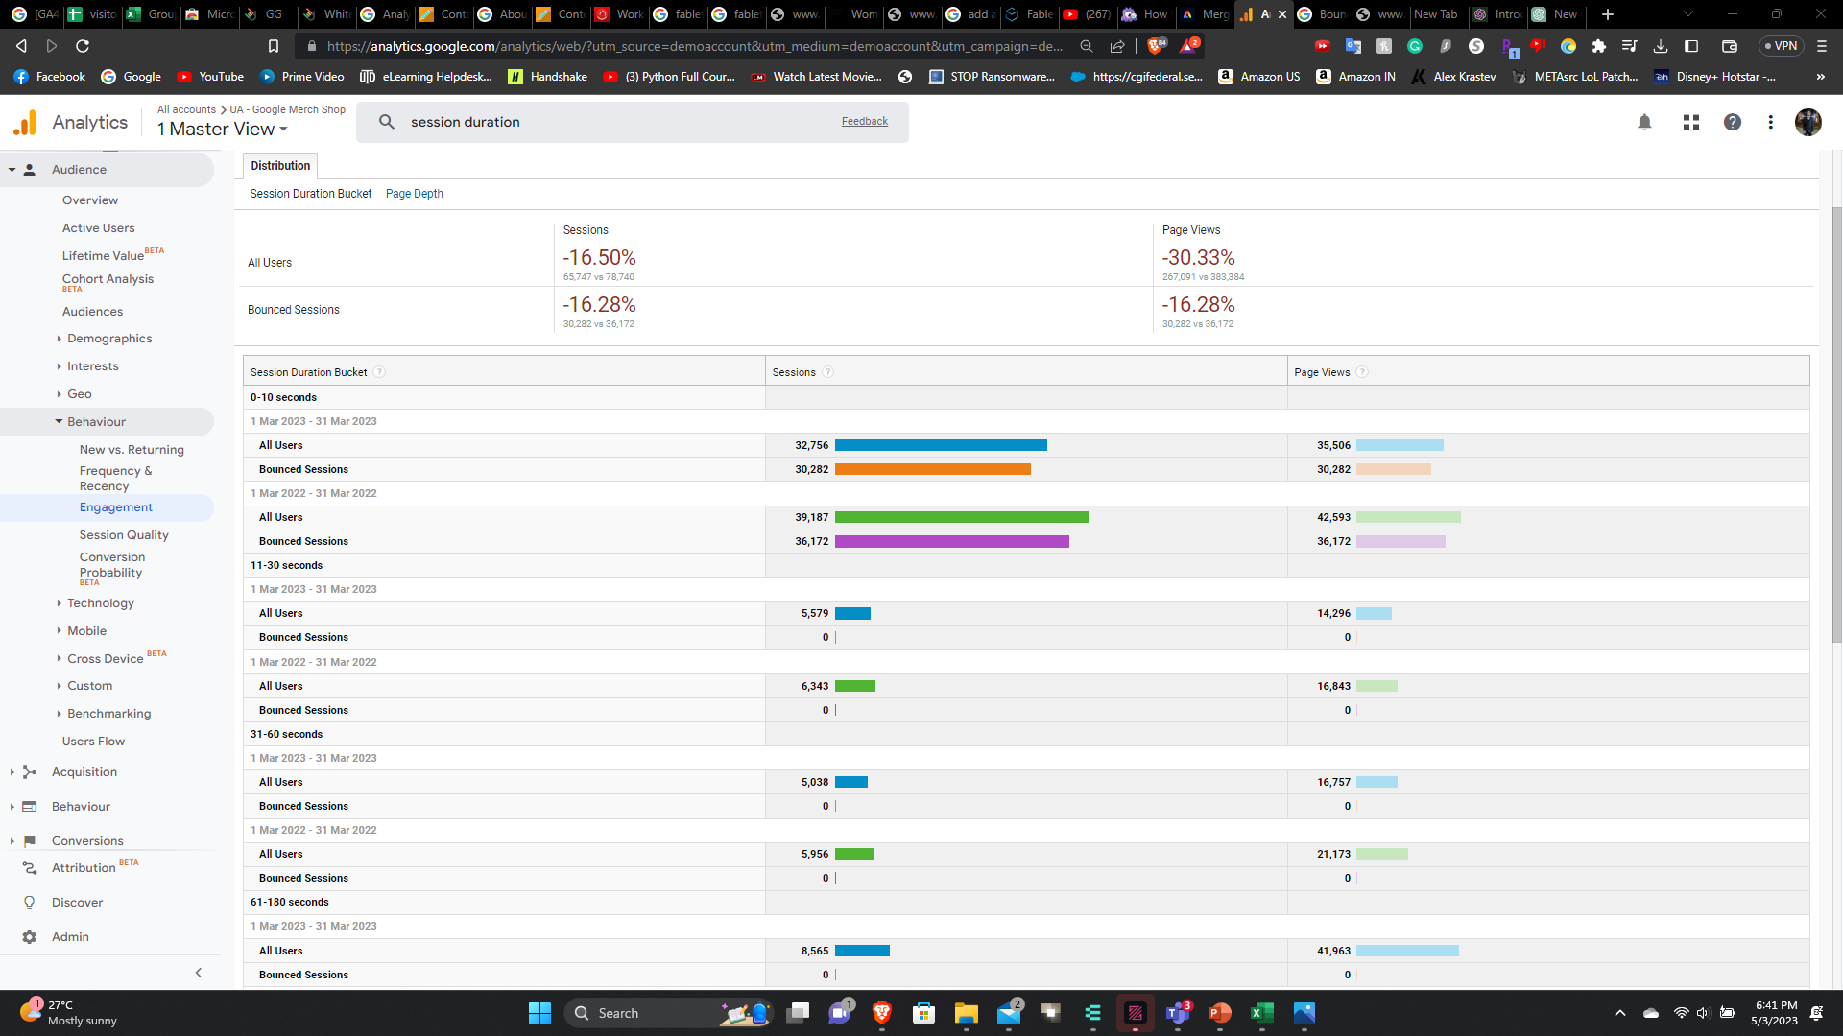
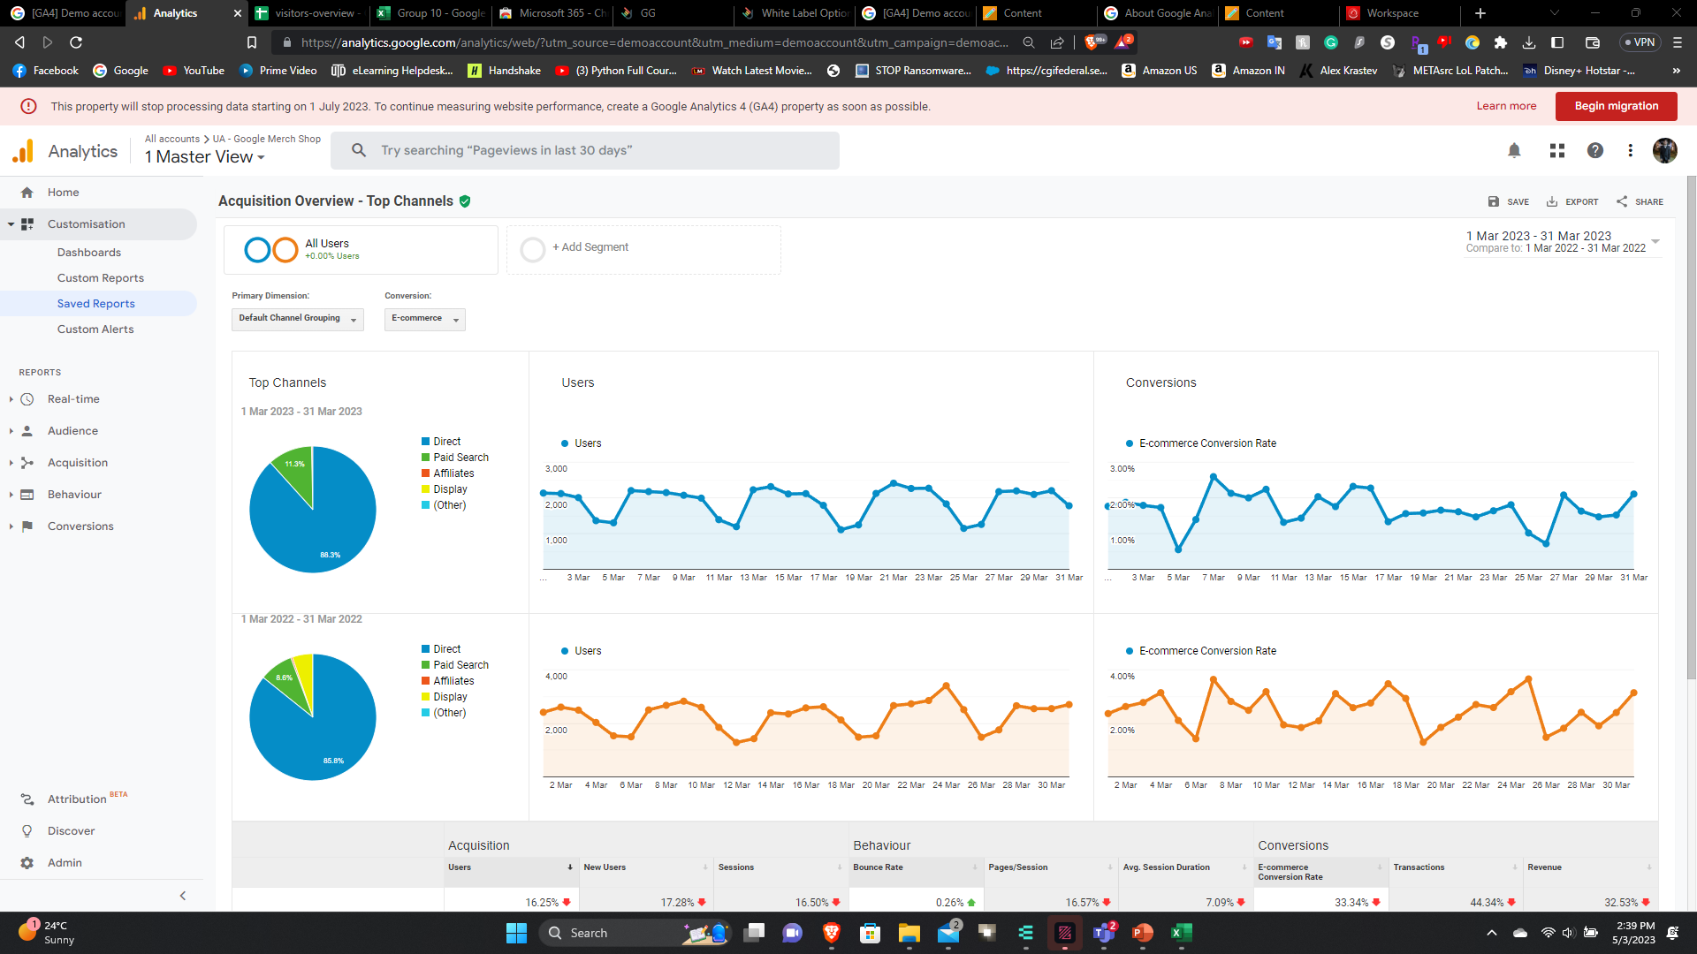
Audience engagement and top channels
The website's performance for March 2023 is: 49,923 users, with 65,747 sessions and an average session duration of 3 minutes and 8 seconds. The bounce rate was 46.06%. Most users came from Direct (57,771 sessions) and Paid Search (7,722 sessions). Affiliates and Display had a smaller number of sessions, while (Other) had the fewest. Compared to March 2022, the website saw a decrease in the number of users and sessions.
It appears that most users are spending less than 10 seconds on the website, which indicates a high bounce rate.

Slide 17
Recommendations
Improve Website UI to increase customer retention
Optimize the website for mobile devices - With more people accessing websites on their mobile devices, it is essential to optimize the website for mobile devices to improve user engagement. This includes making the website mobile-friendly and ensuring that it loads quickly on mobile devices
Use analytics to monitor user behavior - It is essential to monitor user behavior on the website to understand how visitors are interacting with the site. Analytics tools can be used to track user behavior, identify areas of the website that need improvement, and make data-driven decisions to improve user engagement
Improve the website's load time - One possible reason for the high number of sessions with a duration of 0-10 seconds could be slow page load times. Therefore, the website should be optimized for faster loading to provide a better user experience nd encourage visitors to spend more time on the site
Utilize personalized recommendations - Using personalized recommendations can keep users engaged and interested in the website's content. By suggesting related content, users may be more likely to stay on the website longer and interact with more pages.

Slide 18
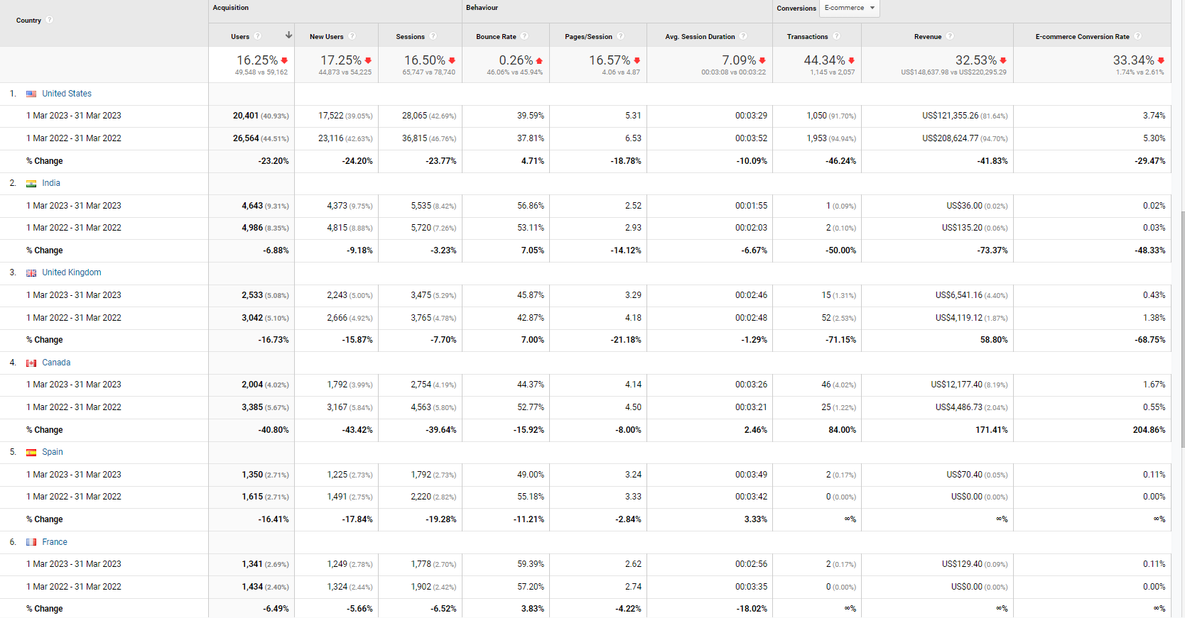




Geographical Distribution of Revenue

Slide 19
Recommendations
Increase in Revenue based on Geographical Regions
Increase the Brand Marketing all over the world
We can see from the geographical distribution that the Country with the most revenue is the United States. Increasing the marketing of products and brand will have a positive impact on the revenue
We recommend to offer lucrative promotions to potential customers by bringing in offers such as BOGO, Frequent Sales, Customer Loyalty Program, Coupon codes, etc.
We also realized that when comparing websites based on regions, www.fableticsindia.com was down. This affects the overall revenue coming from that region
The average session duration also takes a small hit in March 2023, we recommend to focus on redesigning the website in order to extend the session time.
Fabletics seems to focus on Women apparel more than Men. Hence, it should consider expanding their apparel in the Men’s section by conducting an online survey to determine what the male customer thinks about.

Slide 20

Citations
https://www.fabletics.com/about
https://www.fabletics.com/sustainability
https://www.fabletics.com/mens/our-story

